Slide 1
How Can a Wellness Technology Company Play It Smart?
September 4, 2025
Ayodele Omoniyi Ayodeji
Data Analyst

Slide 2
Business Task
Bellabeat wants to grow in the global smart device market.
Task: Analyze Fitbit dataset for user trends.
Goal: Recommend marketing strategies to increase adoption.

Slide 3
Data Sources
Fitbit Fitness Tracker Dataset (Kaggle)
~30 users, ~30 days of data
Data includes: daily activity, sleep, weight, hourly logs
Limitations: small sample, short timeframe, no demographics

Slide 4
Cleaning Process:
Standardized column names & date formats
Removed duplicates & missing values
Joined activity + sleep data
Tools: R (tidyverse, lubridate, janitor)

Slide 5
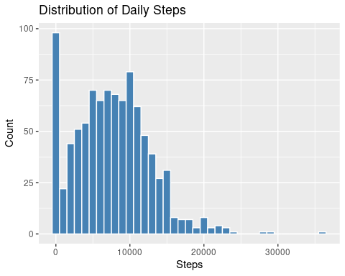
Activity Levels
Avg steps: ~7,500/day (< 10,000 recommended)
Sedentary time: ~16 hrs/day
Very active time: < 1 hr/day

Slide 6
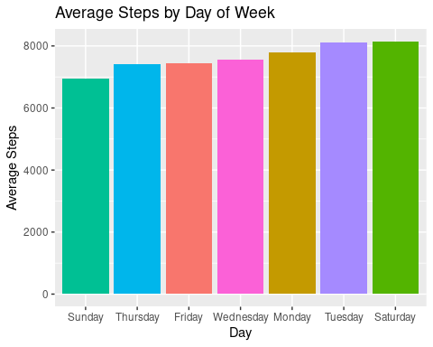
Weekday vs Weekend
Higher activity on weekdays
Drop in steps on weekends
Suggests reliance on structured routines

Slide 7
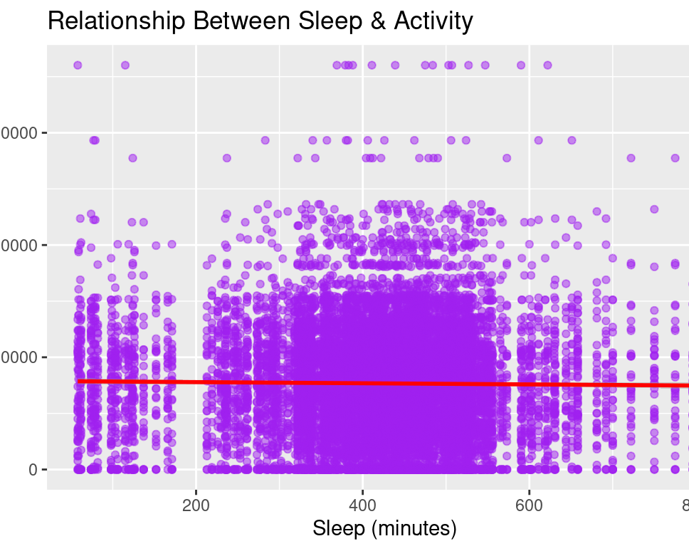
Sleep Patterns
Pvg sleep: ~7 hrs/night (slightly below 7–9 hrs recommendation)
Weak correlation between sleep & steps
Some users show sleep inefficiency (longer in bed vs asleep)

Slide 8
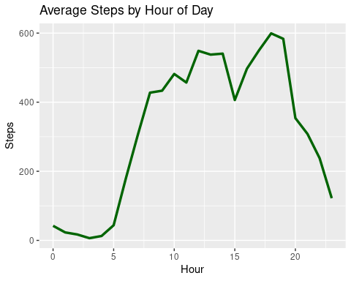
Hourly Activity Trends
Peaks: 7–9 AM & 5–7 PM
Midday = sedentary
Suggests office/work lifestyle influence
25
22
15

Slide 9
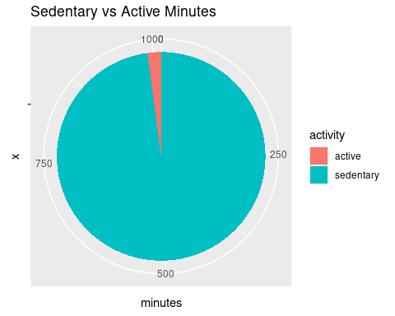
Sedentary vs Active Time
Sedentary minutes (~960/day, or 16 hours).
Very active minutes averaged less than an hour per day.
This imbalance shows the opportunity for smart devices to encourage short, regular activity breaks.

Slide 10
Key Insights (Summary)
Deliverable 1
Users not meeting activity targets
Deliverable 2
Weekday > weekend activity
Deliverable 3
Sleep slightly low, inefficient for some
Deliverable 4
Daily patterns show morning/evening peaks
Midday is mostly sedentary

Slide 11
Recommendations (Marketing Strategy)
Promote Bellabeat as a holistic wellness companion (not just fitness).
Run weekend wellness campaigns to boost activity.
Encourage midday movement via app notifications.
Highlight hydration & sleep tracking features.
Leverage personalized wellness coaching for women.

Slide 12
Conclusion
Data insights reveal opportunities to position Bellabeat as a unique, lifestyle-focused wellness brand.
Recommendations help increase engagement, build habits, and drive market growth.
Thank You

